Slide 1
NBA Teams’ Style of Play
Carter Erickson

Slide 2
Main Goals
Find groups of NBA teams that play similarly
Avoid simply separating good teams from bad teams
Discover differences in groupings between offense and defense
Commentators and reporters offer descriptive terms for teams, but no real metric exists to define style of play

Slide 3
Data Collected
Three sets of data
Offense/Defense mix (Basketball Reference)
Offensive play-by-play (pbpstats.com)
Defensive play-by-play (pbpstats.com)
Data from last 5 seasons to keep style of play relatively accurate among franchises

Slide 4
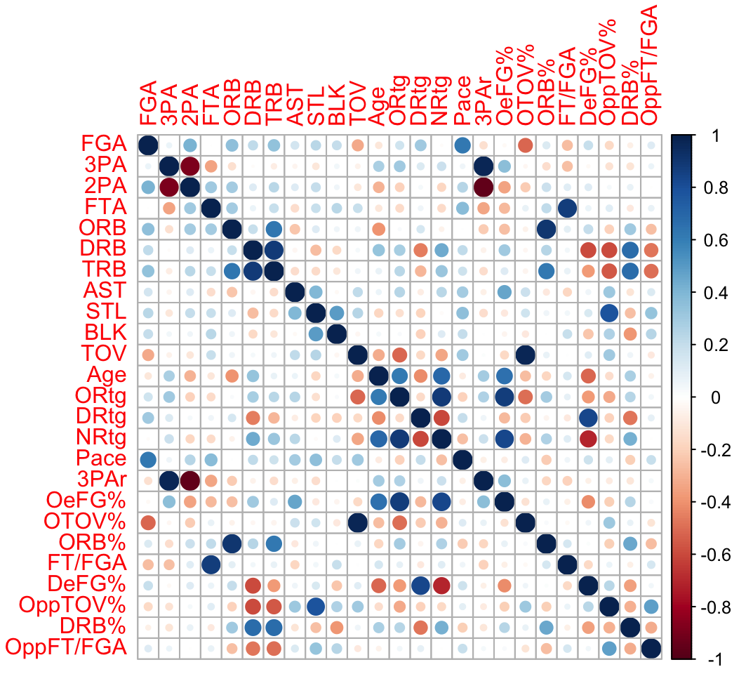
EDA/Variable Selection
Look for unexpected relationships
Age & DeFG% (-)
Age & Pace (+)
Defensive Rebounds & Opponent TOV% (-)
Remove unnecessary variables
LASSO
Pace, NetRtg, and DRtg were all used as response

Slide 5
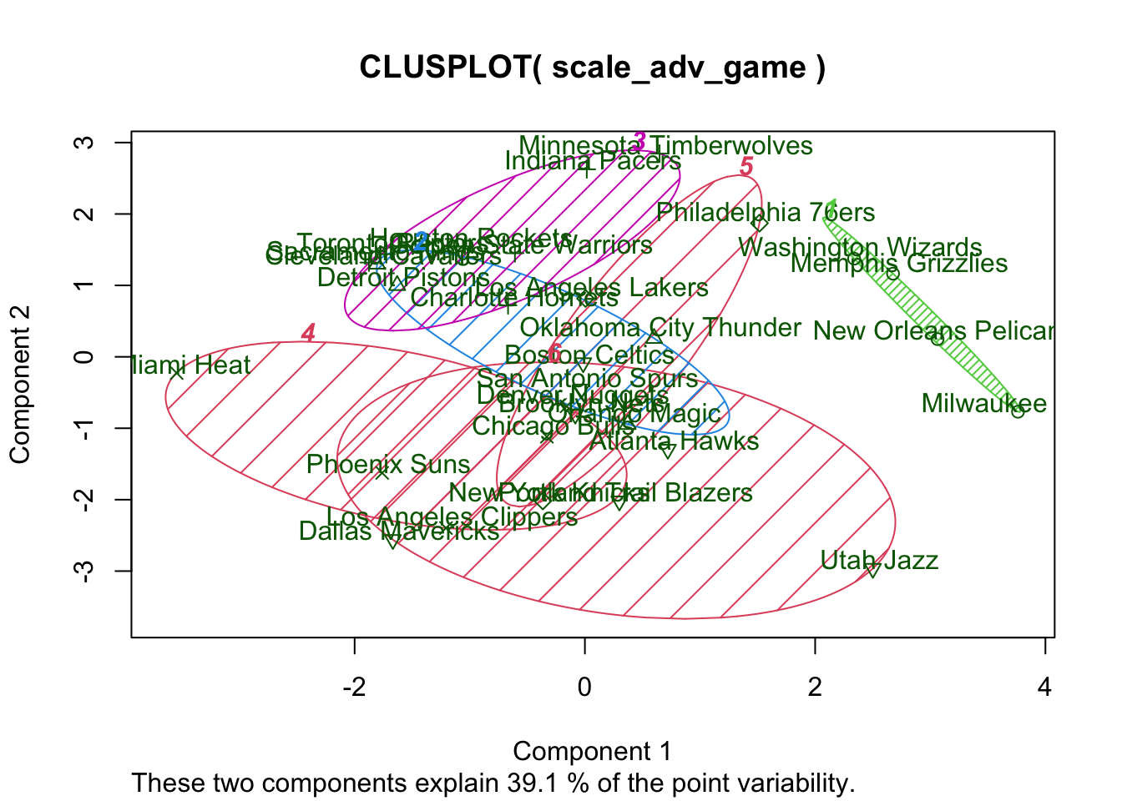
K-Means Cluster Analysis 1 (Offense/Defense Mix)

Slide 6
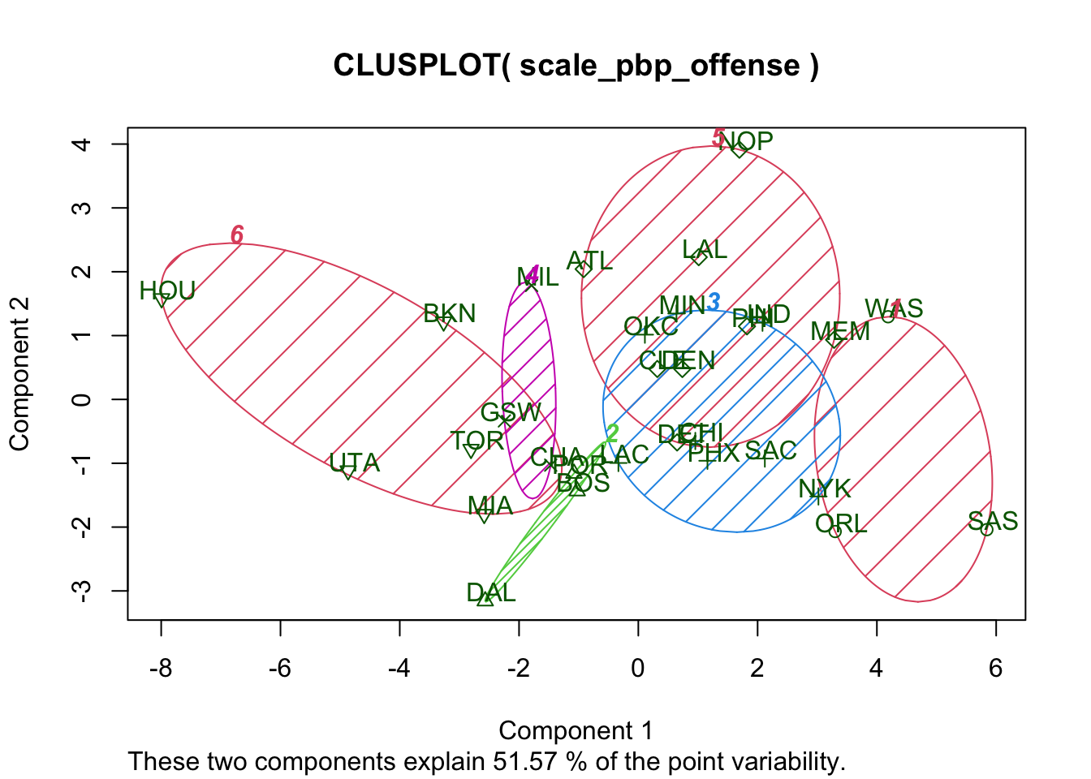
K-Means Cluster Analysis 2 (Offense PBP)

Slide 7
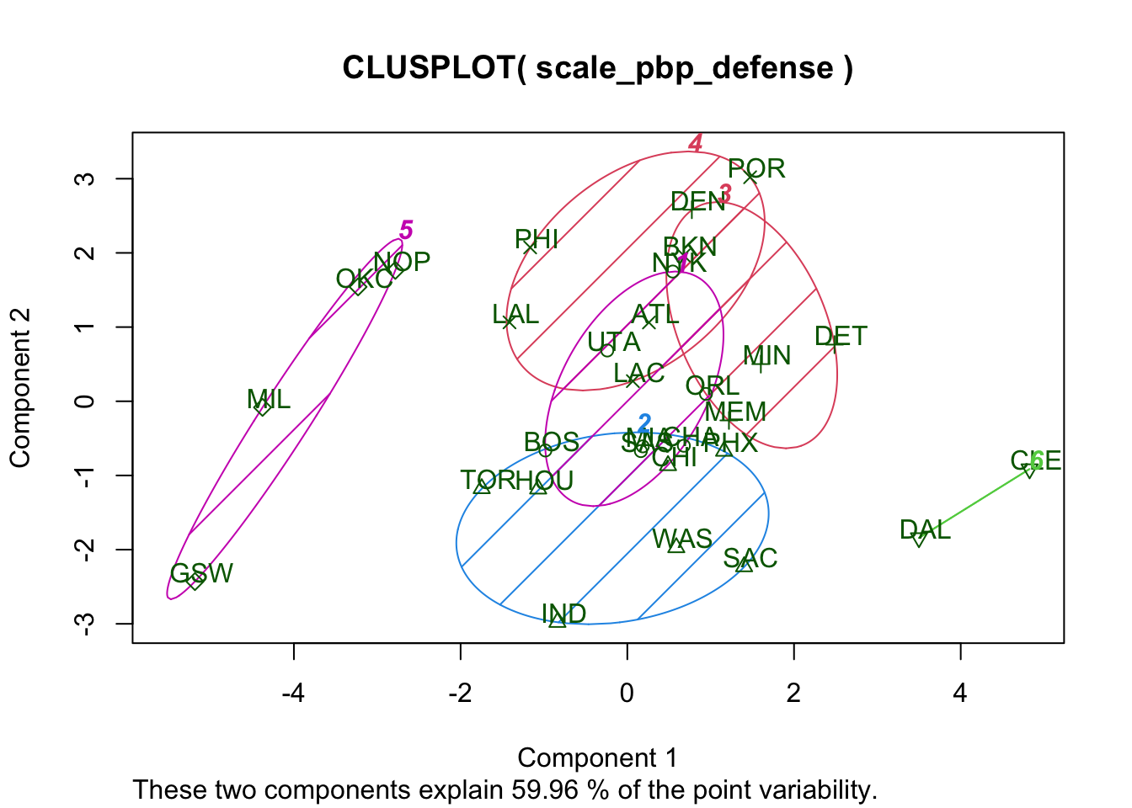
K-Means Cluster Analysis 3 (PBP Defense)

Slide 8
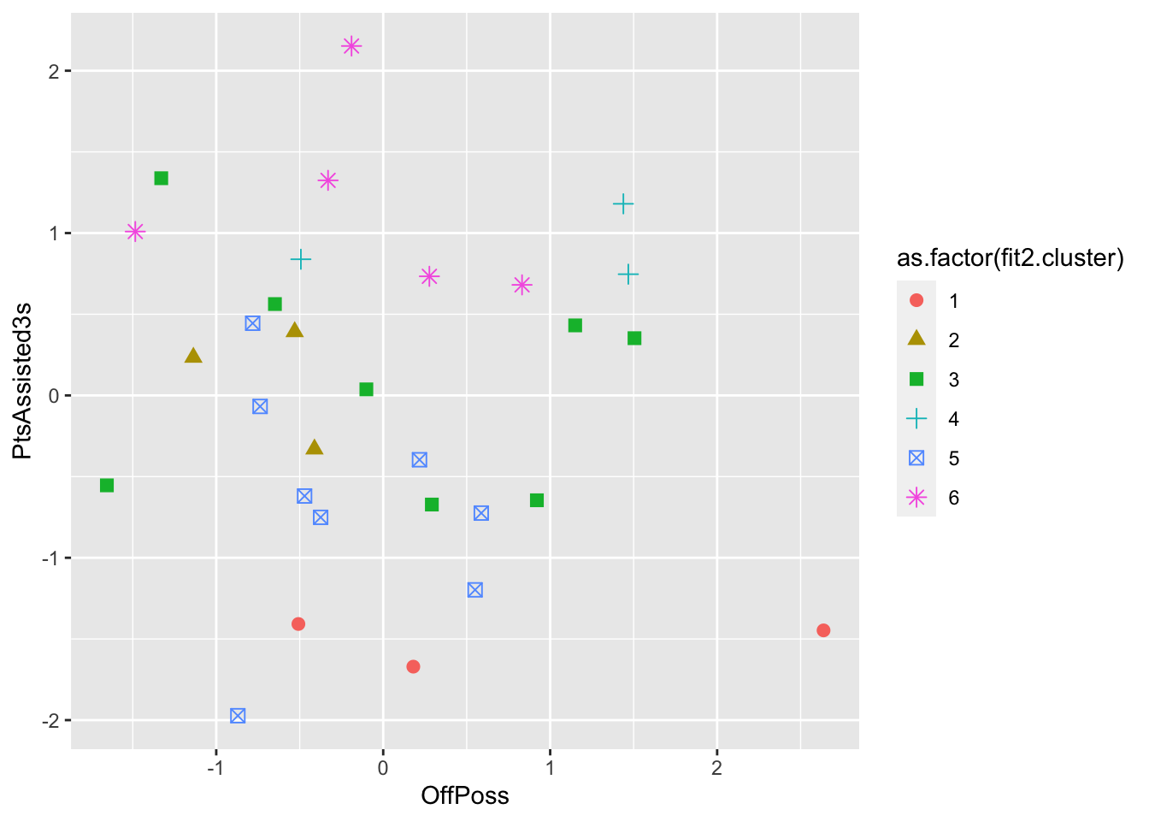
Data Interpretation
Create Shiny app that allows for entry of variables on either axis, as well as changing cluster analysis that was used

Slide 9
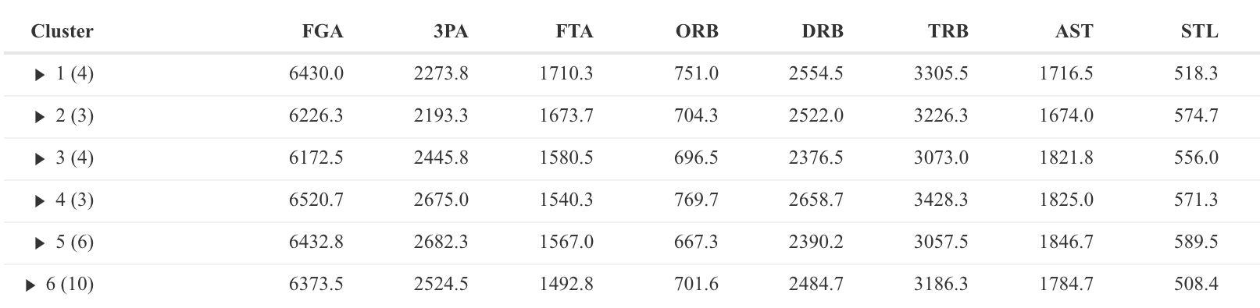
Data Interpretation (cont.)
file:///Users/cartererickson/Desktop/School/STAT/STAT%20495R/NBA-Style-of-Play-Project.html

